Slide 1
Cotton Disease Prediction
Group - 95

Slide 2


Agenda
A
Introduction
Gantt Chart
Deep Learning Using Resnet50
Website
Future Goal

Slide 3
Introduction
Cotton is also called “White Gold” and “The King of Fibers. ” For growers, processors, exporters, and producing countries, cotton is the earnest point of supply. This work presents cotton plant disease detection using image processing technique for automated vision system used at agricultural field. In agriculture research of automatic plant disease detection is essential one in monitoring large fields of crops and thus automatically detects symptoms of disease as soon as they appear on plant leaves. It is very difficult for a farmer to identified various disease in plants. The estimated annual crop losses due to plant disease at the worldwide is $60 Billions. The traditional tools and techniques are not very useful since it takes lots of time and manual work.

Slide 4
Gantt Chart
Work Flow Chart

Slide 5
Work Flow
Project Design | September | October | November | December | January | February | March
Goal Identification
Project Approval
Get Dataset For project
Frontend Development
Backend Development
Testing
Deployment

Slide 6
Deep Learning Using Resnet50
Backend Work

Slide 7
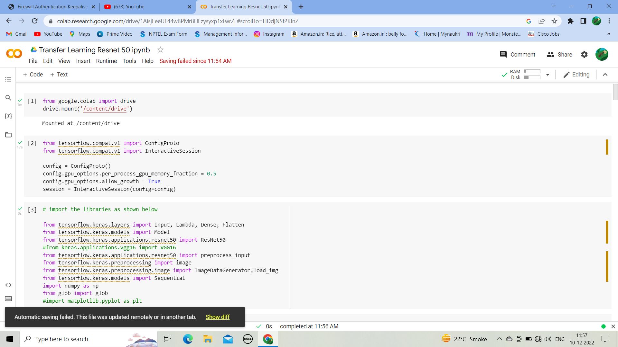
Work Flow

Slide 8
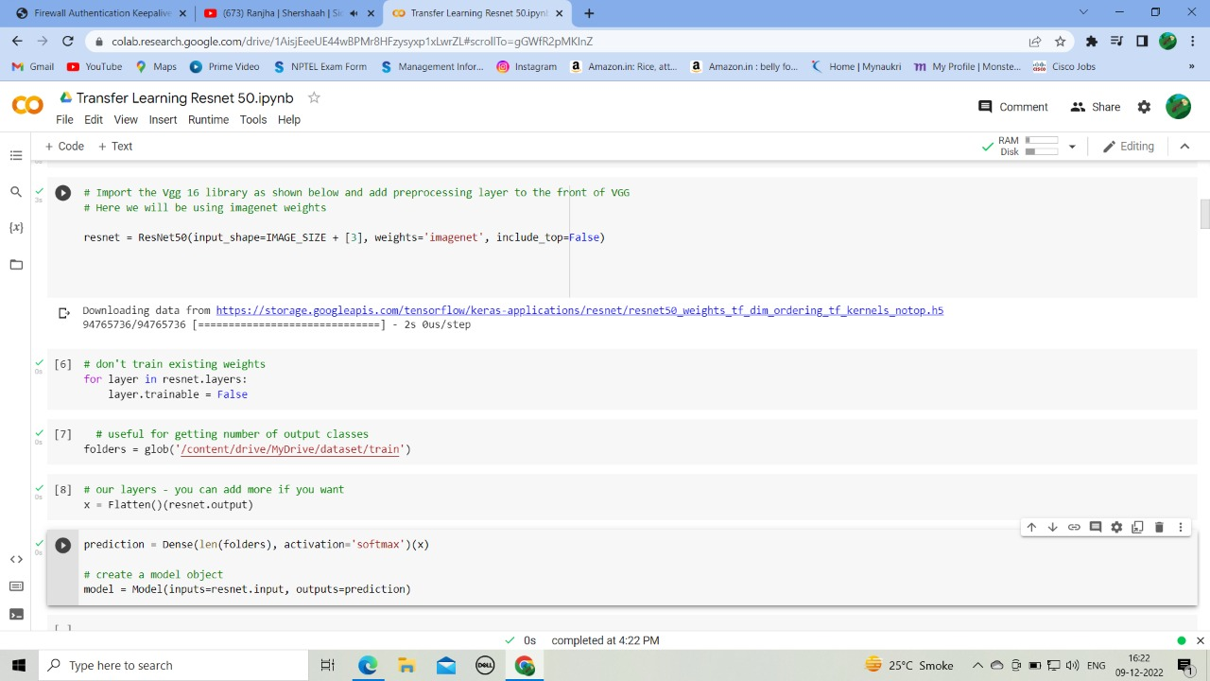

Slide 9
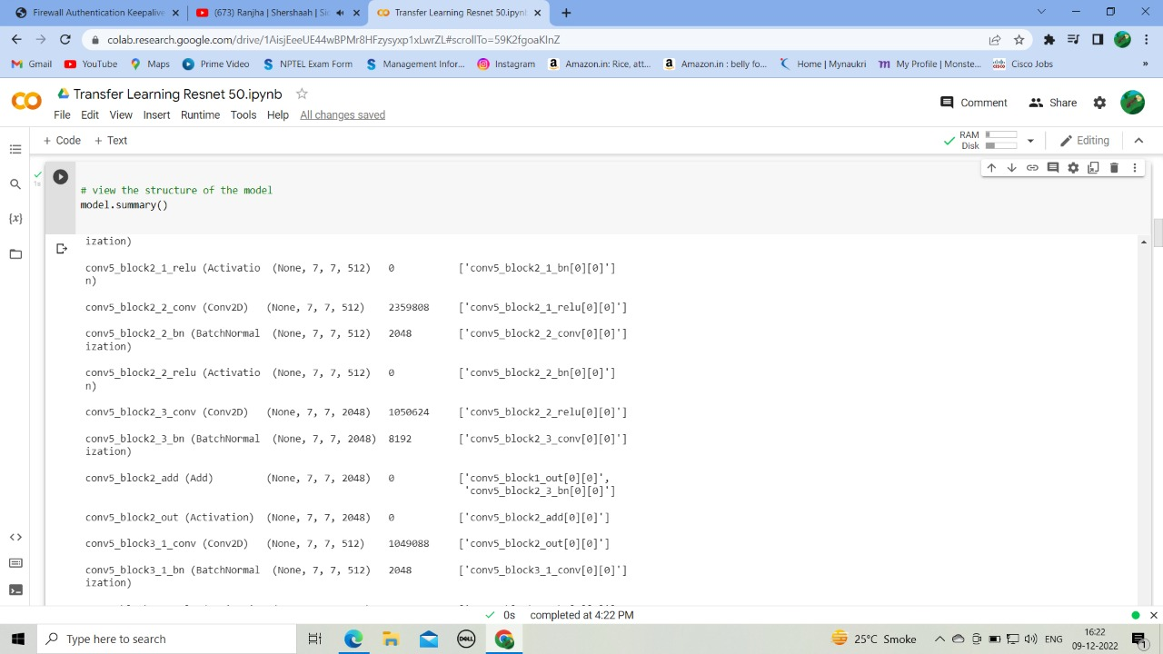

Slide 10
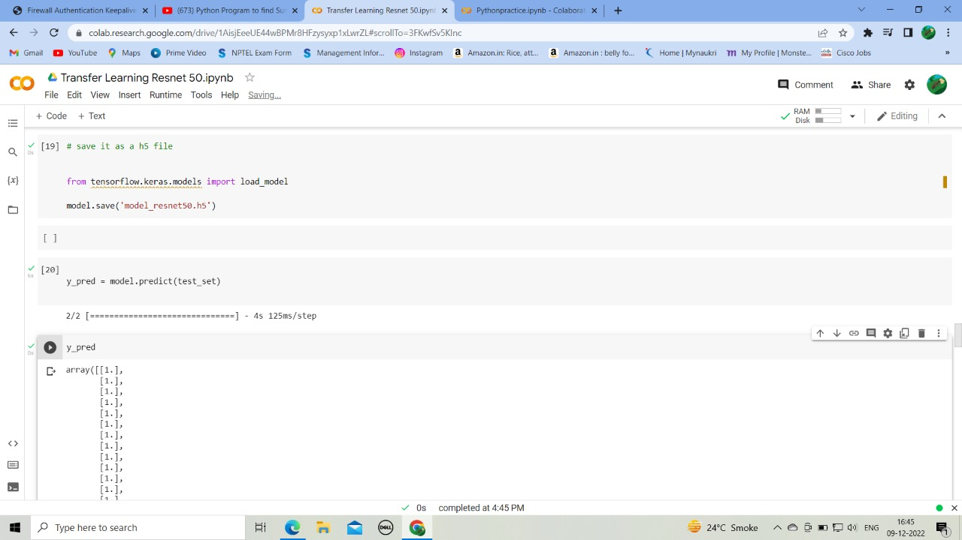

Slide 11
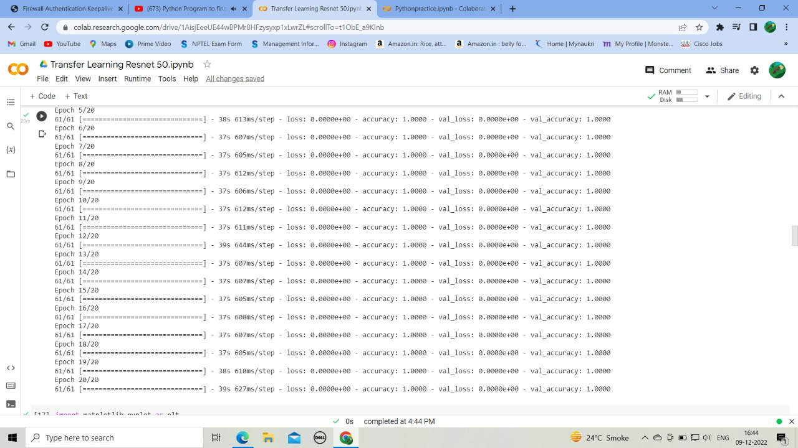

Slide 12
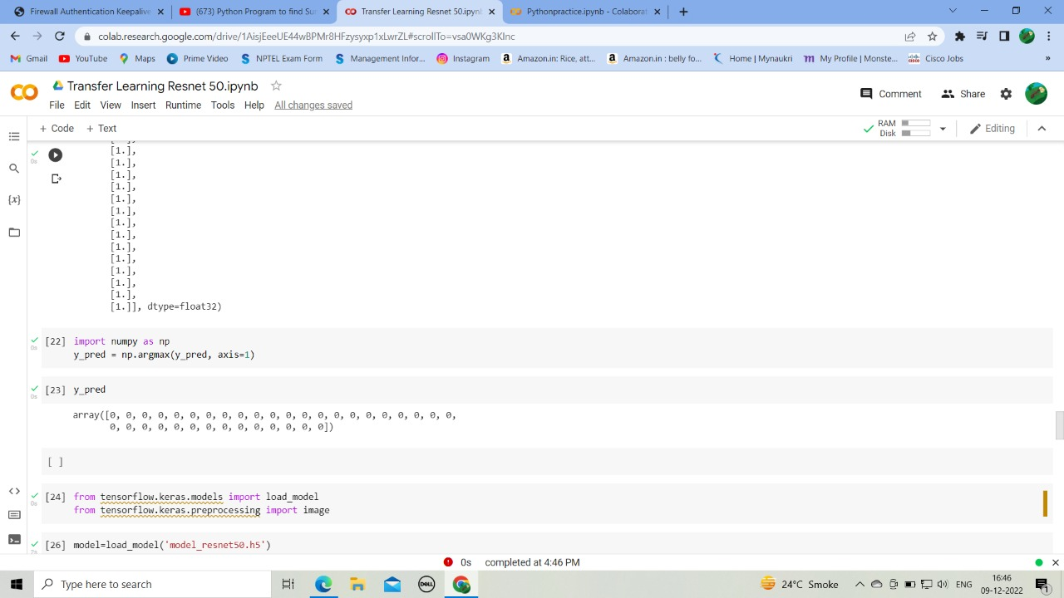

Slide 13
Website

Slide 14
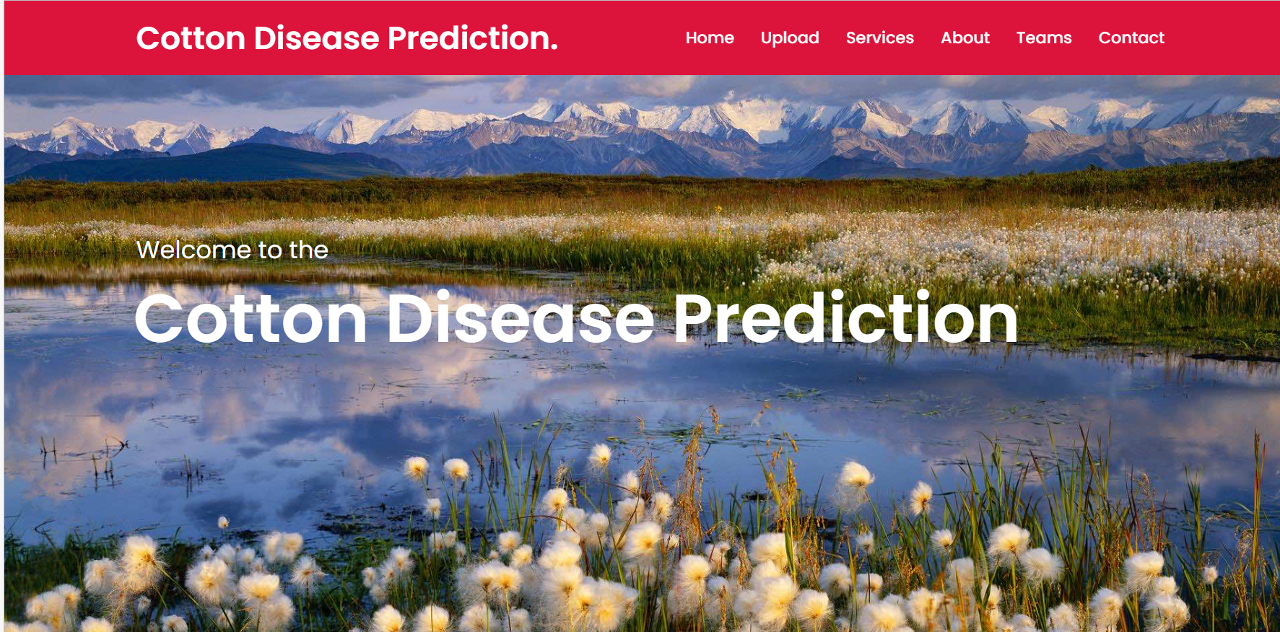
First Page

Slide 15
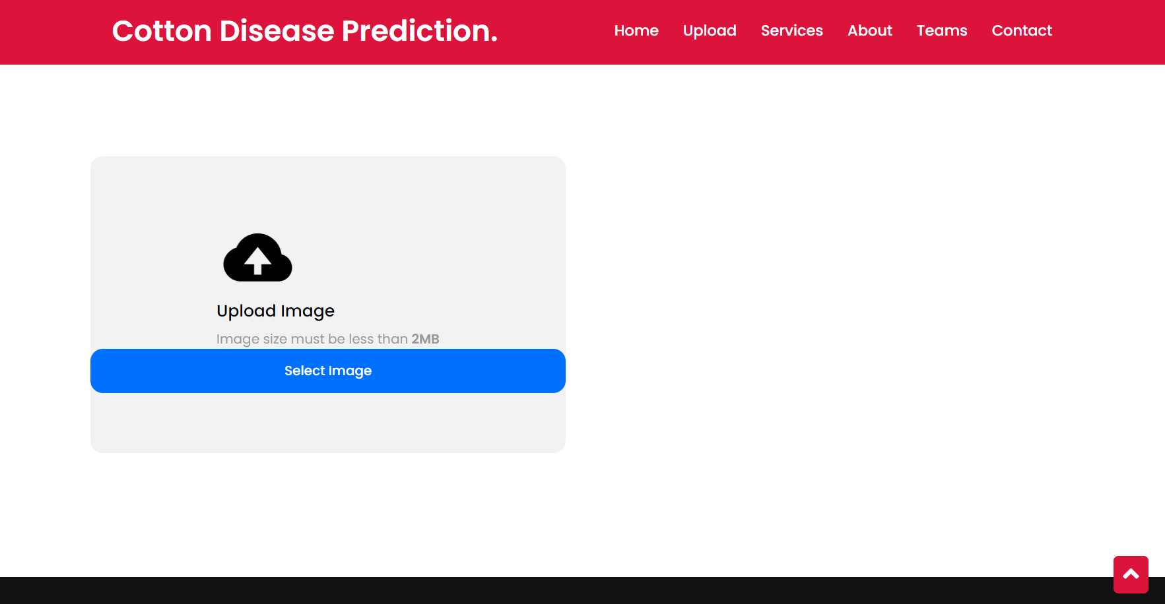
Upload Page

Slide 16
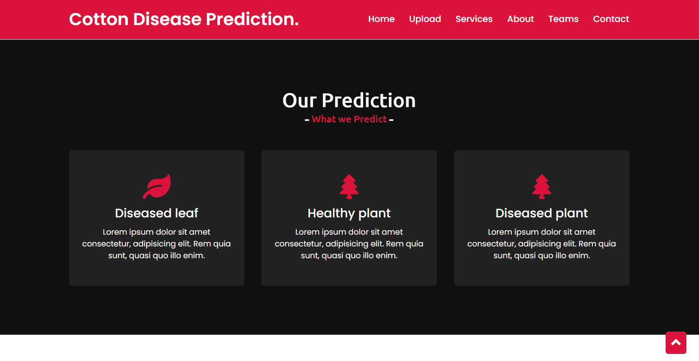
Prediction Page

Slide 17
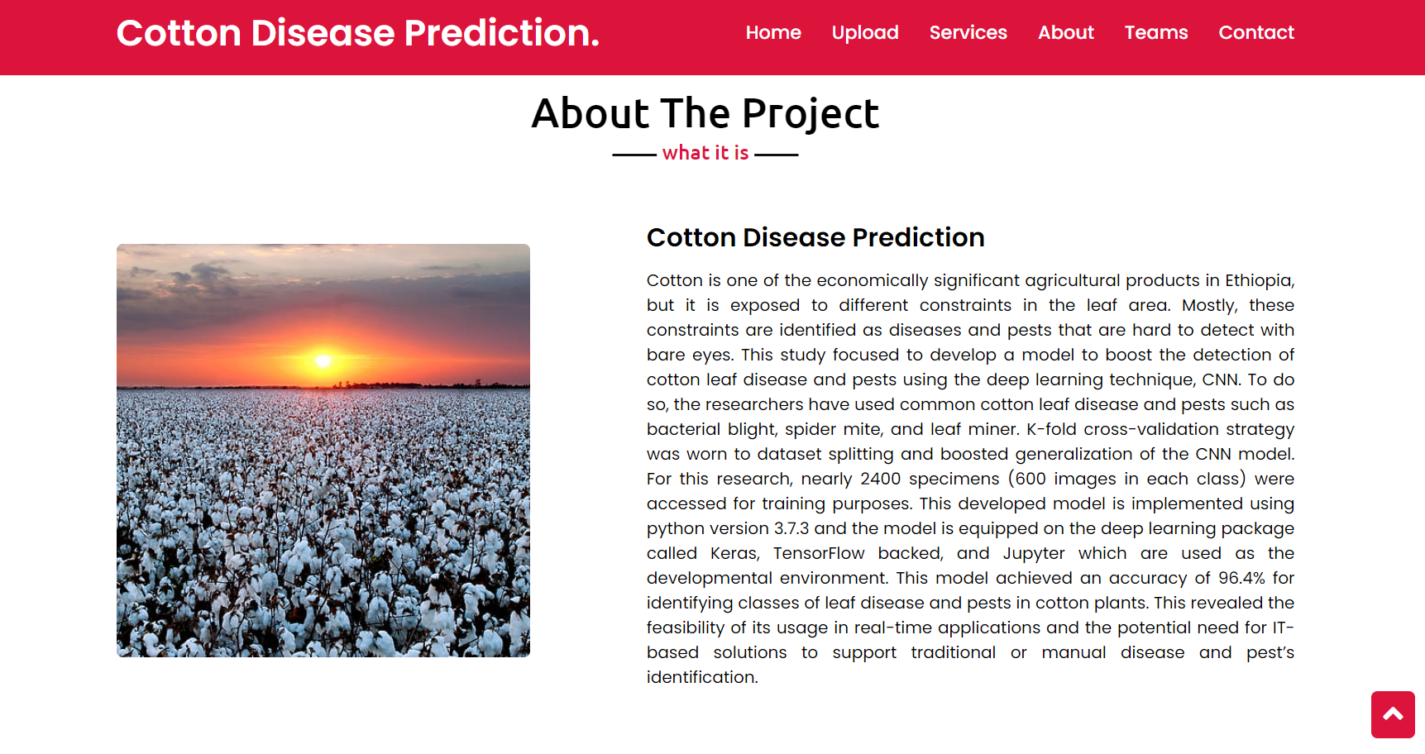
About Page

Slide 18
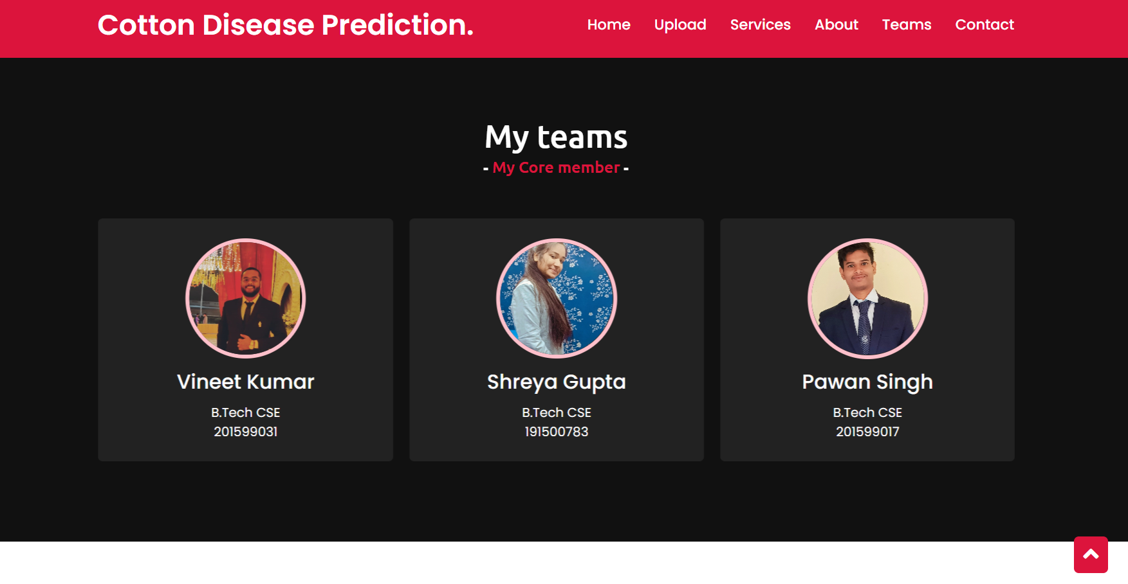
Team Members

Slide 19
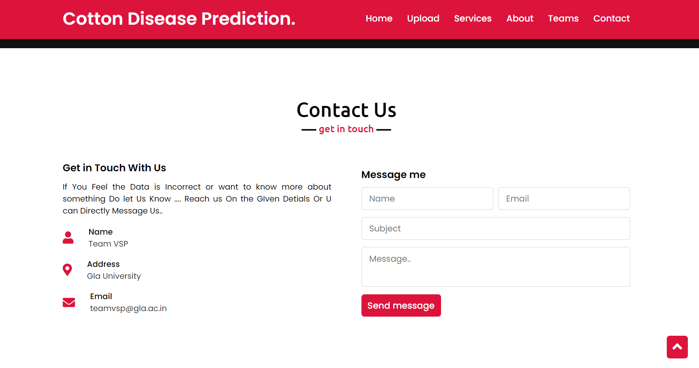
Contact Us

Slide 20
Future Goal

Slide 21
This area of research appears to have great potential in terms of increased accuracy. It will implemented along with several visualization techniques to detect and classify the symptoms of plant diseases. It will provides a comprehensive explanation of DL models used to visualize various plant diseases. In addition, some research gaps will identify from which to obtain greater transparency for detecting diseases in plants, even before their symptoms appear clearly

Slide 22
Thank you
Presented by G-95
Do you have any
questions for us?

